Slide 1




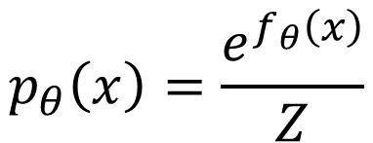
…
$$f_{θ}\left(x\right)$$
$$e^{f_{θ}\left(x\right)}$$
$$p_{θ}\left(x\right)=\frac{e^{f_{θ}\left(x\right)}}{Z}$$
…
positive
normalize
$$x$$
Generative Model

Slide 2
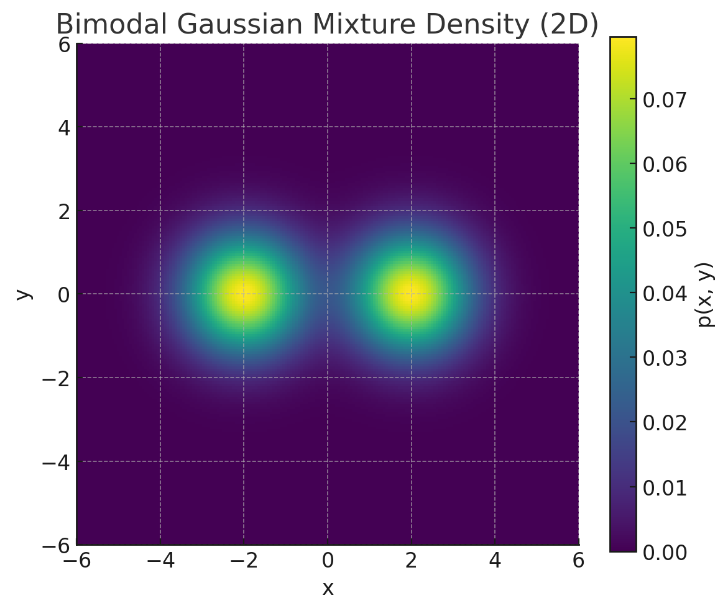
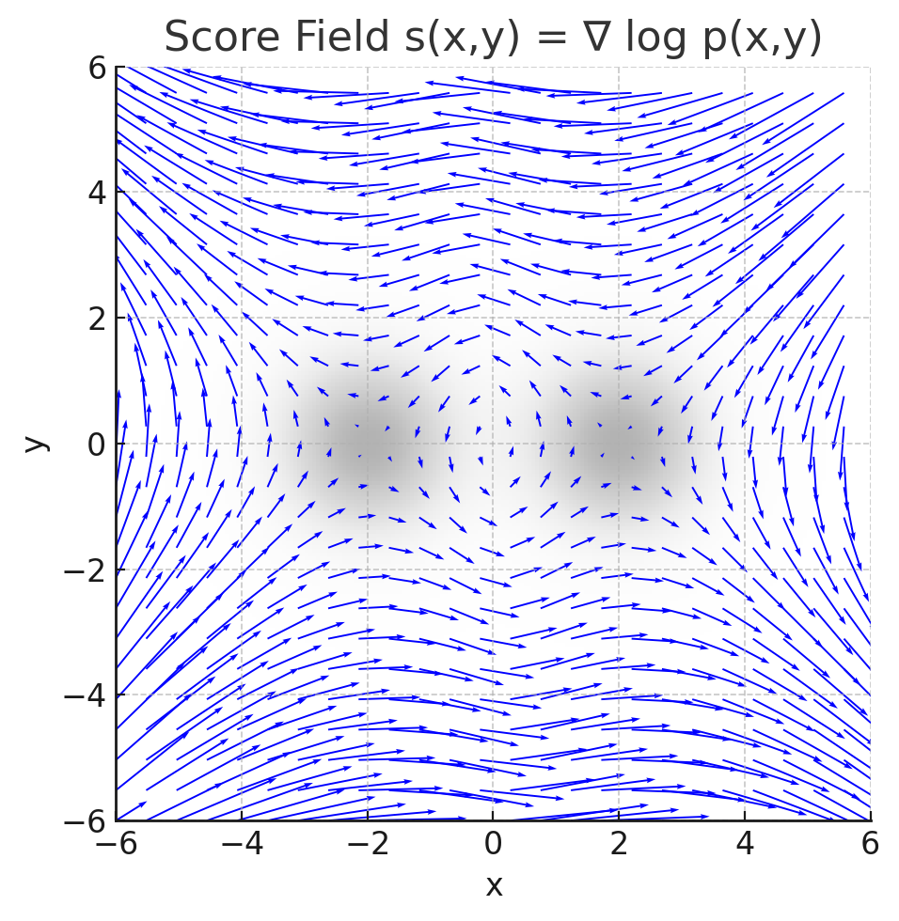
Probability Density
Score Function

Slide 3
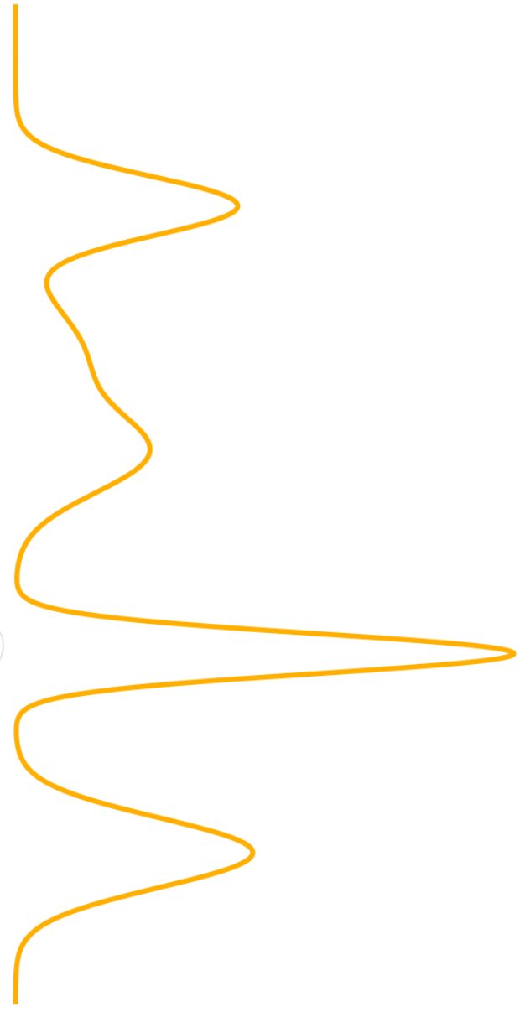
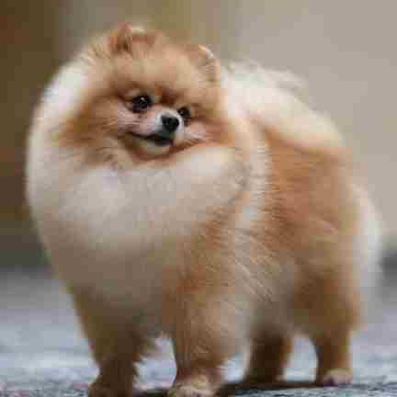
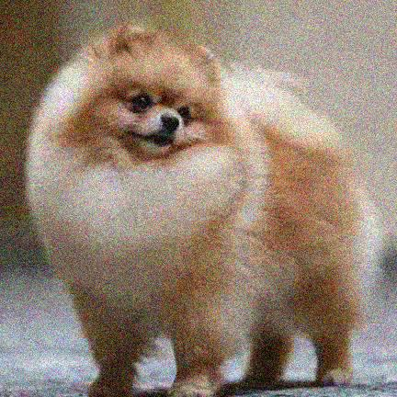

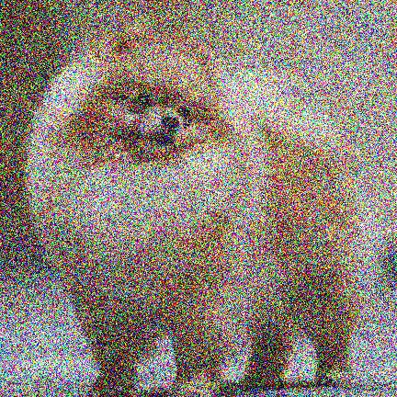
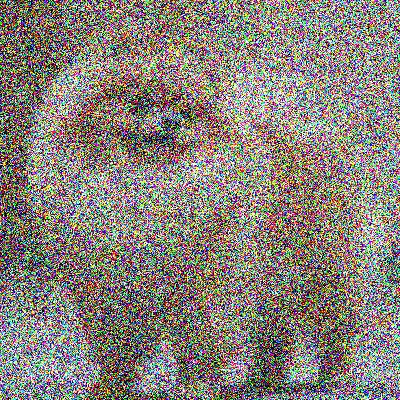
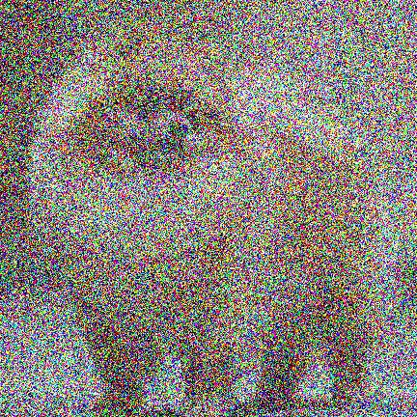
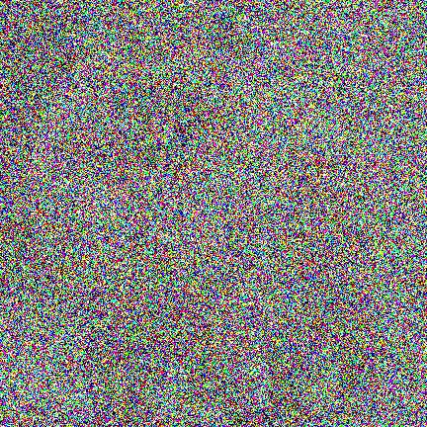
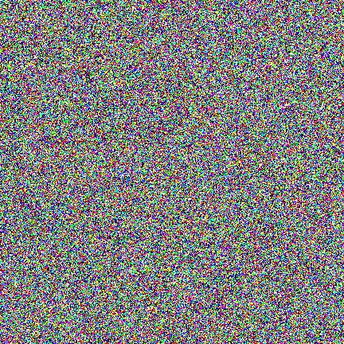
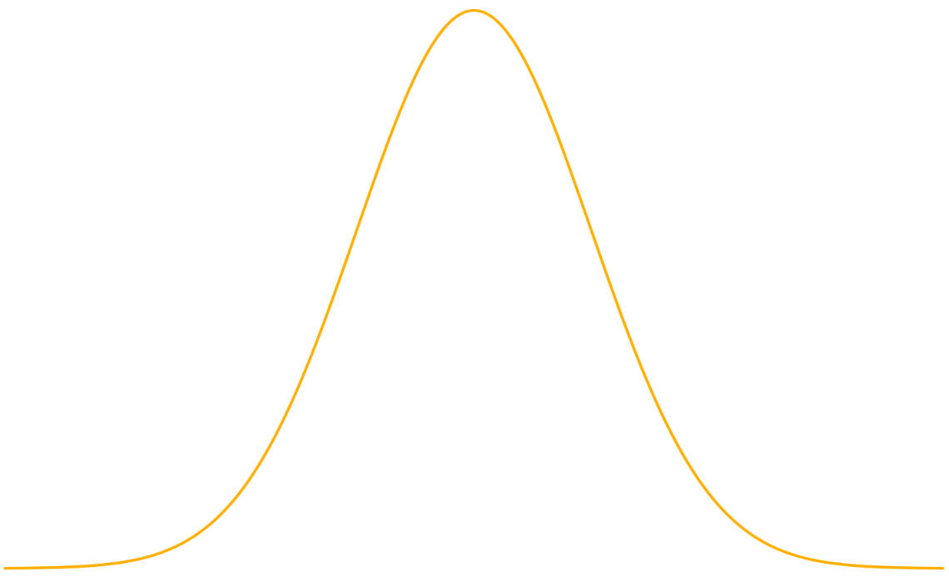












$$p_{data}$$
$$p_{init}$$
PF-ODE
$$f_{θ}\left(x_{t_{4}}, t_{4}\right)$$
$$t_{4}$$
$$t_{3}$$
$$t_{2}$$
$$t_{1}$$
$$t=0$$
$$t=T$$
$$f_{θ}\left(x_{t_{3}}, t_{3}\right)$$
$$f_{θ}\left(x_{t_{2}}, t_{2}\right)$$
$$f_{θ}\left(x_{t_{1}}, t_{1}\right)$$

Slide 4











$$x_{0} \sim p_{data}$$
Adversarial Loss
Forward Diffusion Process
Real / Fake
$$G_{φ}$$
$$φ$$
$$x_{s}=α\left(s\right)x_{0}+σ(s)ε$$
Student Model
$$x_{0}^{s}$$
Distillation Loss
Forward Diffusion Process
$$d\left(x_{0}^{s},x_{0}^{T} \right)$$
$$Φ_{ψ}$$
$$ψ$$
$$x_{t}=α\left(t\right)x_{0}+σ(t)ε$$
Teacher Model
$$x_{0}^{T}$$

Slide 5



$$p_{teacher} \left(p_{T}\right)$$
Teacher Model
Student Model
$$p_{noise}$$
$$p_{student} \left(p_{S}\right)$$

Slide 6
Fast Sampling for Diffusion Model
ODE Solver
Distillation-Based
Flow-Based
DDIM
Pseudo-Numerical Methods
PLMS, PRK
High-Order ODE Solver
DEIS
DPM-Solver，DPM-Solver++
UniPC
Trajectory Distillation
Progressive Distillation
Consistency Trajectory Distillation
Score Distillation
Score Distillation Sampling
Score Implict Distillation
Distribution Distillation
Distribution Matching Distillation
Consistency Distillation
Looking for more optimal trajectory
Flow Matching
Rectified Flow
InstraFlow
MeanFlow
Training-Free
Training-Based

Slide 7



















$$t_{8}$$
$$t_{7}$$
$$t_{6}$$
$$t_{5}$$
$$t_{4}$$
$$t_{3}$$
$$t_{2}$$
$$t_{1}$$
$$t_{0}$$
Teacher
Distillation
$$t_{4}$$
$$t_{3}$$
$$t_{2}$$
$$t_{1}$$
$$t_{0}$$
Distillation
$$t_{2}$$
$$t_{1}$$
$$t_{0}$$
Distillation
$$t_{1}$$
$$t_{0}$$
Student

Slide 8
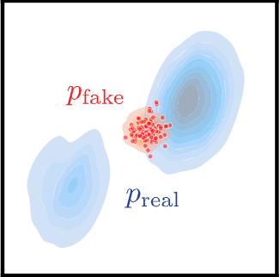
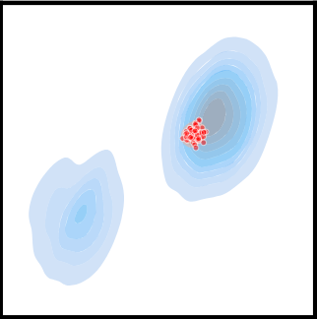
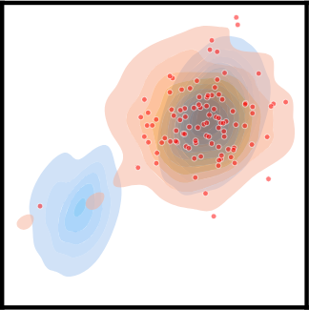
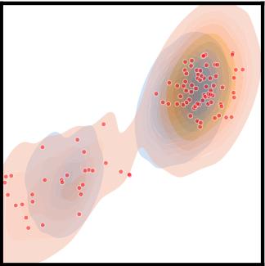
Real Score
Real / Fake Score
Initial State
Distribution-Matching Loss
DML + Regression Loss

